Slide 1
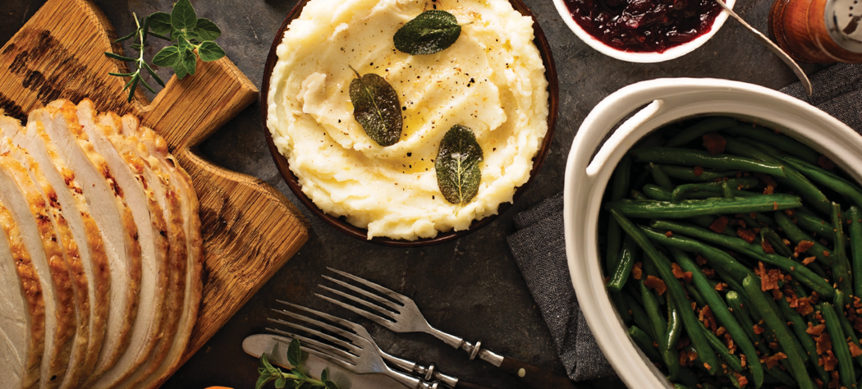
Keep your
pans clean this
Thanksgiving!
Thanksgiving Meal Kits Available!
PRE-ORDERS ACCEPTED THROUGH: November XX, 2020

Slide 2
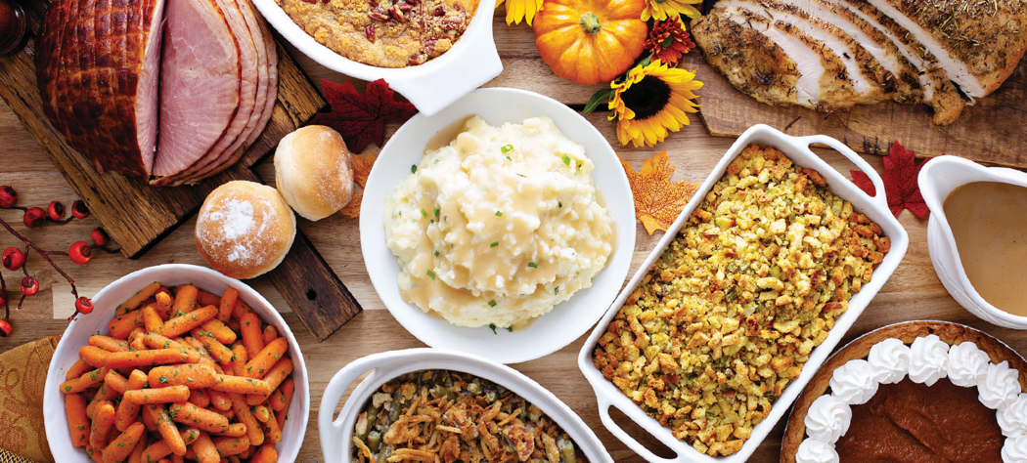
Keep your
kitchen clean this
Thanksgiving!
Open for Takeout & Delivery
PRE-ORDERS ACCEPTED THROUGH: November XX, 2020

